Slide 1

Fort Ord Reuse Authority (FORA)
Environmental Services Cooperative Agreement (ESCA)
Remediation Program (RP)
ESCA Remediation Program Update
Presentation by:
Stan Cook, Program Manager
October 11, 2013 Board of Directors Meeting
1

Slide 2
Status / Challenges
“Known” MEC field work now complete.
Regulators may request further investigation.
Lengthy document review process (160 days).
U.S. government shut down delays.
2

Slide 3
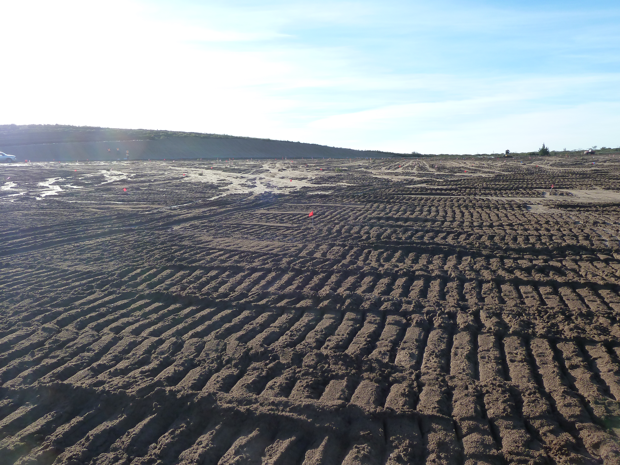
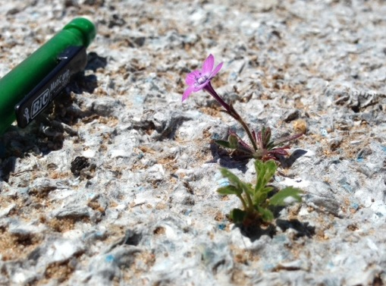
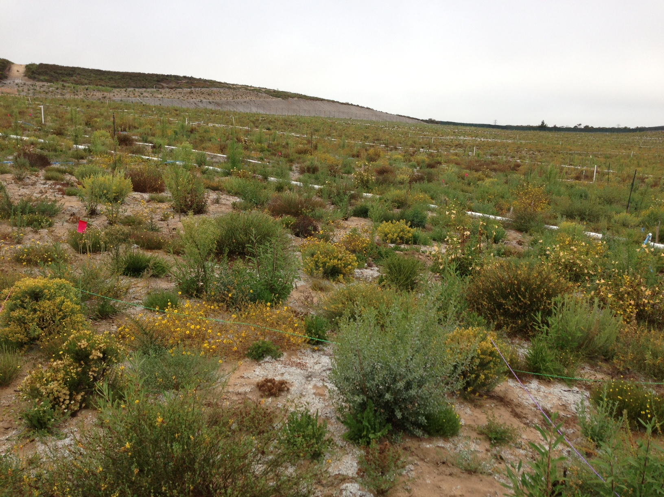
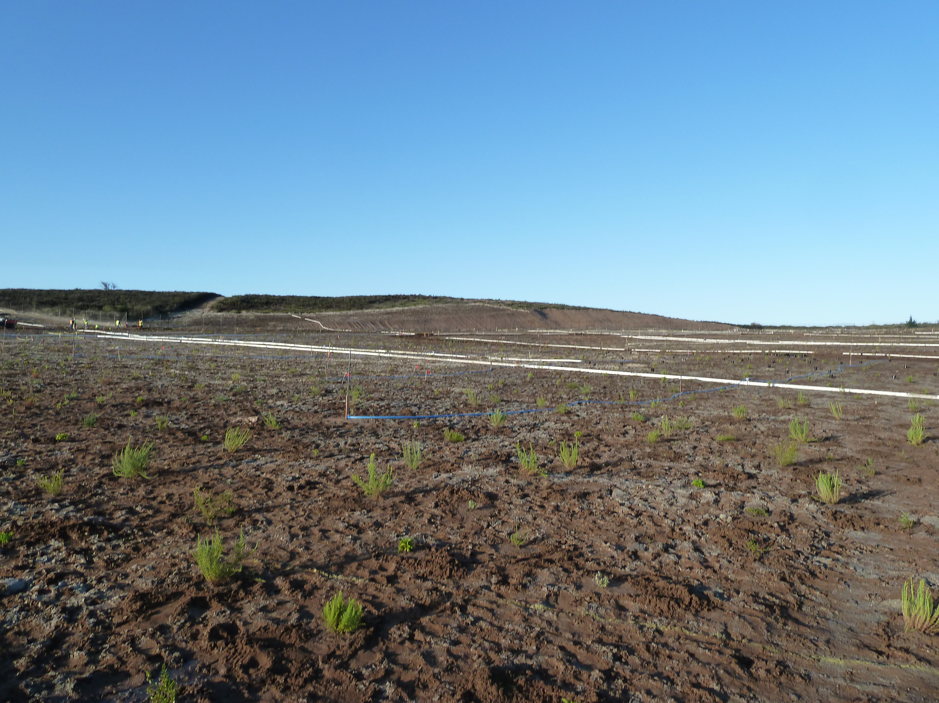
Interim Action Ranges Habitat Restoration
January 2013
Sand Gilia
September 2013
February 2013
3

Slide 4
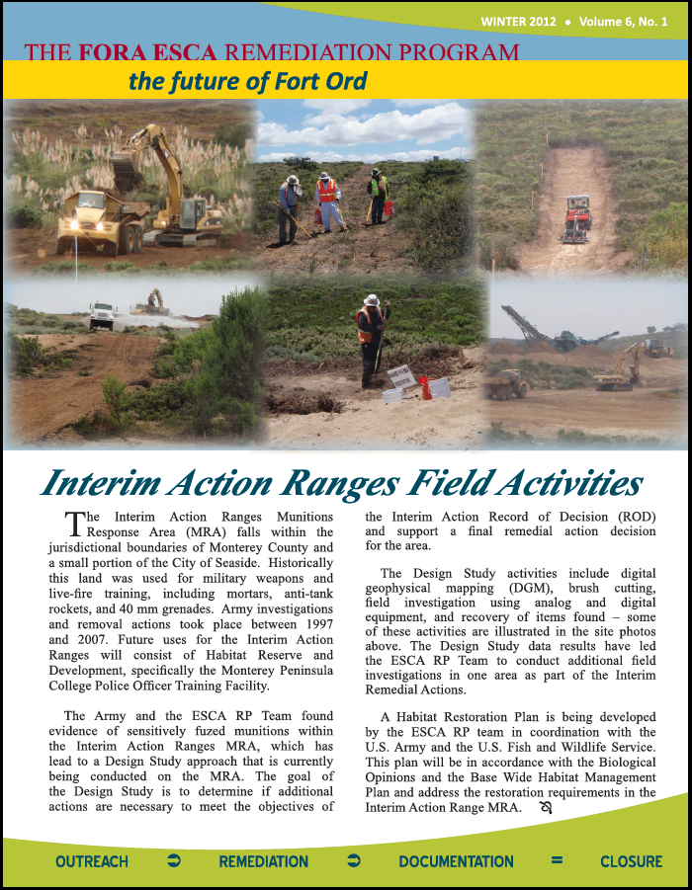
Community Resources
Website: www.fora-esca-rp.com
Newsletters & Technical Fact Sheets
Facebook and Twitter: FORA ESCA RP
Hotline Weekly Updates: (831) 883-3506
Maps showing access corridors
Kiosks at access corridor trailheads
Email: esca@fora.org
Address: 920 2nd Ave Suite A, Marina, CA 93933
4

Slide 5
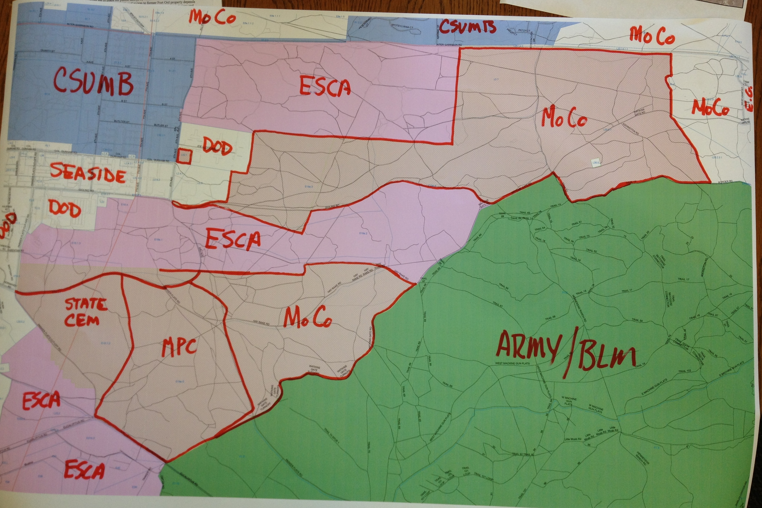
5

